Slide 1


CAPSTONE DESIGN 02 PRESENTATION
NETWOD
Team 14
Kim Jeonghoon 20146235
Min Sungjae 20145223 (Presenter)
Go Sungju 20165245

Slide 2
01 Weekly plan
02 Progress
INDEX
03 Problems & Solutions
04 Next week plan
05 Github

Slide 3
1 ”
Weekly plan

Slide 4

01
Weekly plan
Plan
02
 | 2nd | 3rd | 4th | 5th | 6th | M I D D E M O
Jeonghoon,Kim | Defining data structure for database | Basic android UI design& develop |  | Basic android app function design&develop | Integrating modules & Test
Sungjae,Min | Making excel sheet template& Data collection | Implementation of excel parsing module | Implementation of App database
Sungju,Go |  | WOD data collection& data store to data structure | Implementation of WOD generating module
 | 9th | 10th | 11th | 12th | 13th | F I N D E M O
Jeonghoon,Kim | Community android UI design& develop |  | Community android app function design & develop |  | Integrating modules& test
Sungjae,Min | Build community server system |  | DB system implementation & Build data transfer module
Sungju,Go | Implementation of statistical function
03
04

Slide 5
2”
Progress

Slide 6
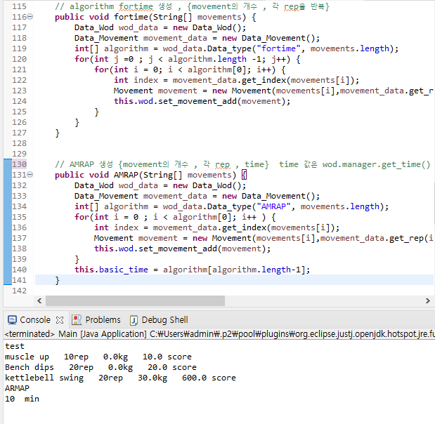
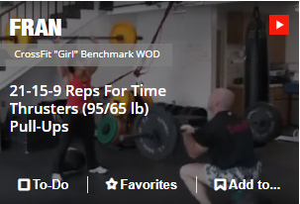
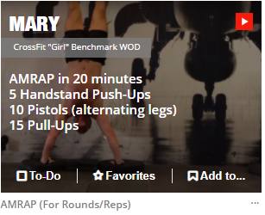
03
Progress
Progress
01
Wod Function & Wod score
02
Type of WOD
04
Fortime
AMRAP

Slide 7
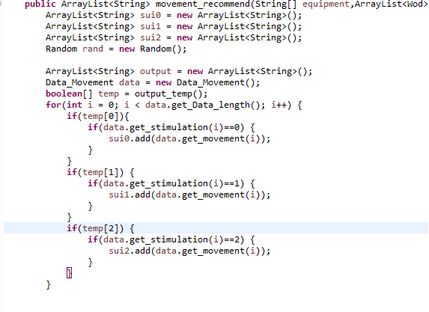

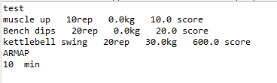
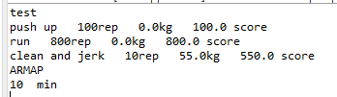
03
Progress
Progress
01
Wod Function & Wod score
02
04
Recommend movement
By equipment
Equipment currently available

Slide 8
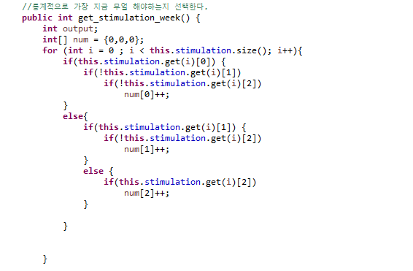
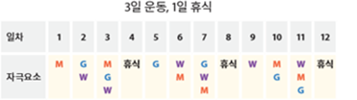
03
Progress
Progress
01
Wod Function & Wod score
02
04
Recommend movement
By weekly plan
Type of exercise less than average

Slide 9
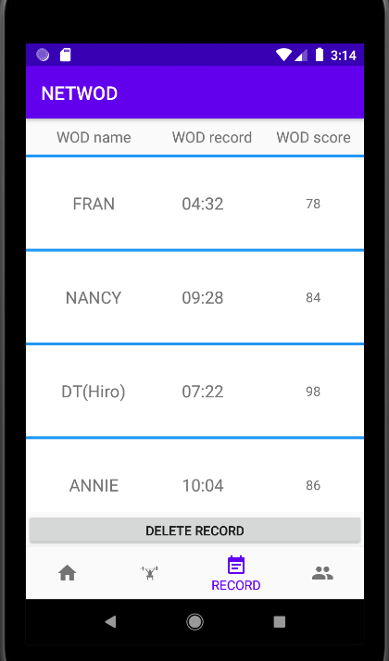
03
Progress
Progress
01
02
WOD Record List
04
UI that allows users to view exercise records
performed as a list.
WOD name , WOD record , WOD score

Slide 10
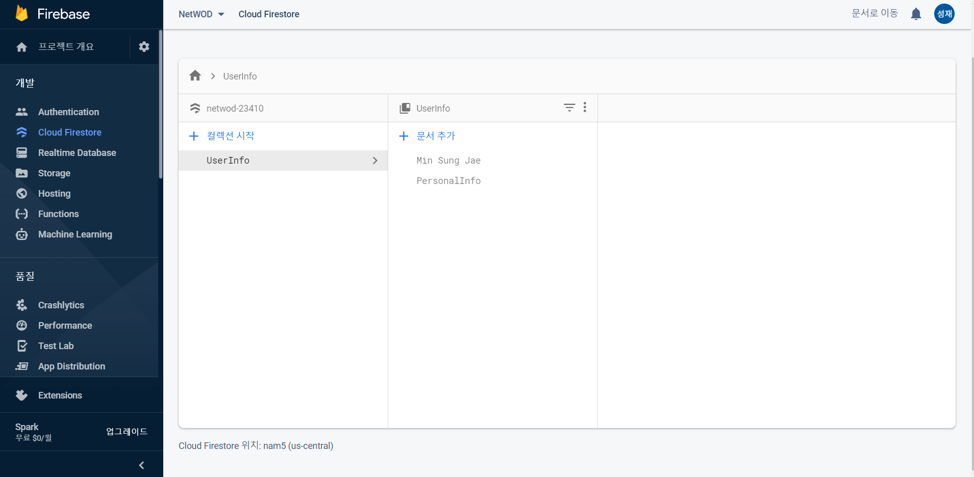
03
Progress
Progress
01
Firebase Console
02
04
Status of console before signing up

Slide 11
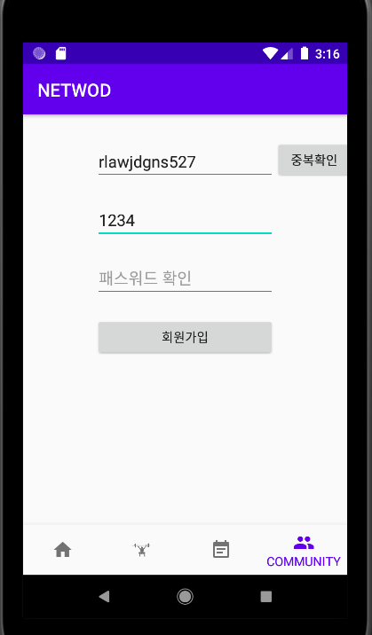
03
Progress
Progress
01
Signup UI
02
04
Get User ID , Password

Slide 12
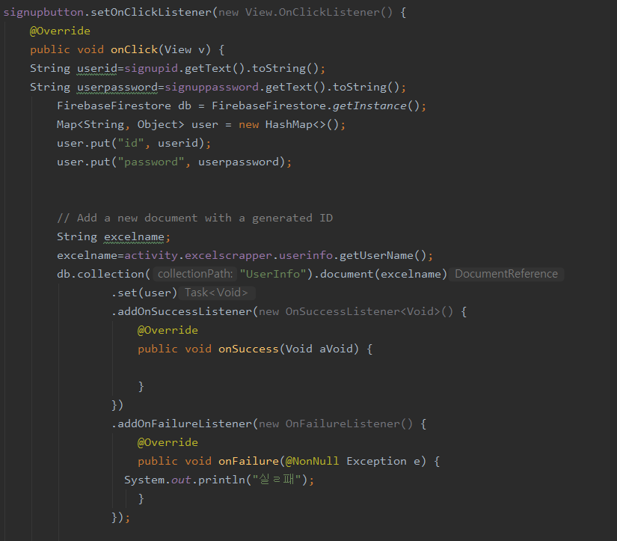
03
Progress
Progress
01
02
Code in Android
04
Get User ID , Password
-> Send ID , Password
To Firebase

Slide 13
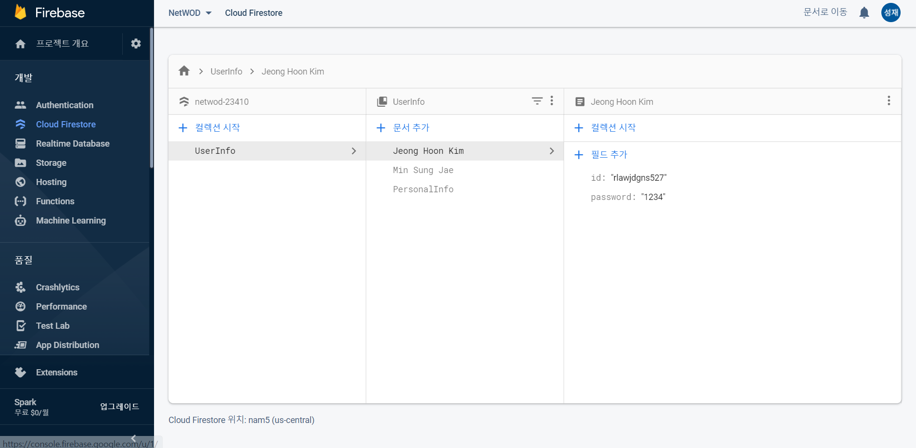
03
Progress
Progress
01
Firebase Console
02
04
The information was updated
in real time

Slide 14
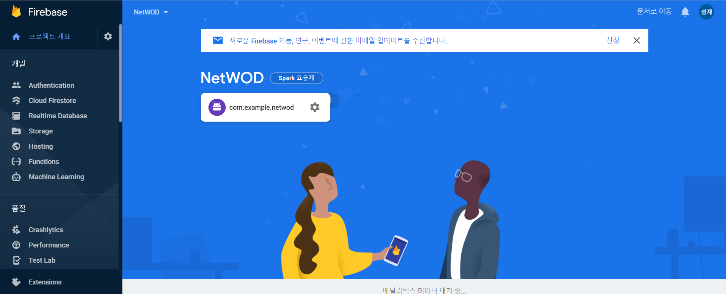
03
Progress
Progress
01
Firebase link to Android
02
04
In Firebase Console,
Add Android Studio Project

Slide 15
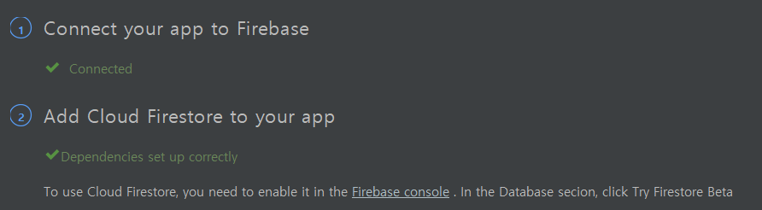
03
Progress
Progress
01
Firebase link to Android
02
04
In Android Studio
Connect Firebase ( build gradle , xml )

Slide 16
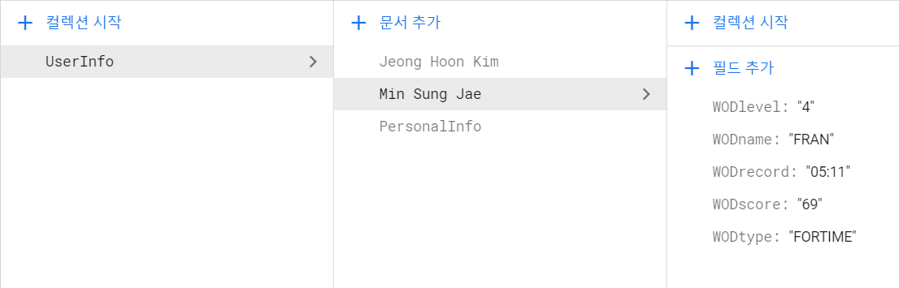
03
Progress
Progress
01
Use Firestore ( Realtime NoSQL DB )
02
04

Slide 17


03
Progress
Progress
01
02
04
Get Data
Set Data

Slide 18
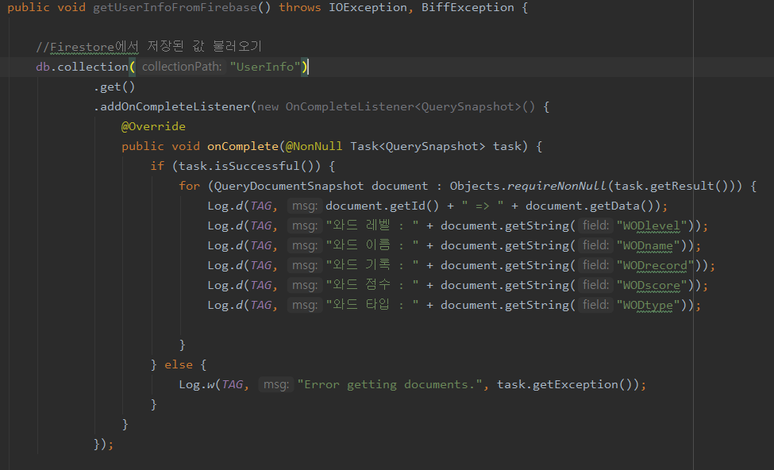
03
Progress
Progress
01
02
04

Slide 19
3”
Problems & Solutions

Slide 20
03
Problem & Solutions
Progress
01
How to get data from Firebase to Android??
02
04

Slide 21
03
Problem & Solutions
Progress
01
02
How to get data from Firebase to Android??
04

Slide 22
4”
Next week plan

Slide 23
04
Next
Next
01
 | 2nd | 3rd | 4th | 5th | 6th | M I D D E M O
Jeonghoon,Kim | Defining data structure for database | Basic android UI design& develop |  | Basic android app function design&develop | Integrating modules & Test
Sungjae,Min | Making excel sheet template& Data collection | Implementation of excel parsing module | Implementation of App database
Sungju,Go |  | WOD data collection& data store to data structure | Implementation of WOD generating module
 | 9th | 10th | 11th | 12th | 13th | F I N D E M O
Jeonghoon,Kim | Community android UI design& develop |  | Community android app function design & develop |  | Integrating modules& test
Sungjae,Min | Build community server system |  | DB system implementation & Build data transfer module
Sungju,Go | Implementation of statistical function
02
03

Slide 24
5”
Github Activity

Slide 25
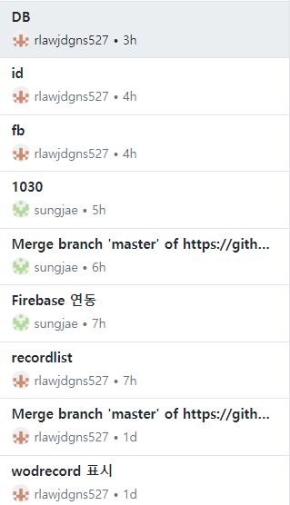
05
Github Activity
Github
01
02
03

Slide 26

Thank You!

